Slide 1
Lesson 11
Spring MVC Framework
Infinite Diversity Arising from Unity
Notes:
https://www.youtube.com/watch?v=YYvOGPMLVDo
MVC Song

Slide 2
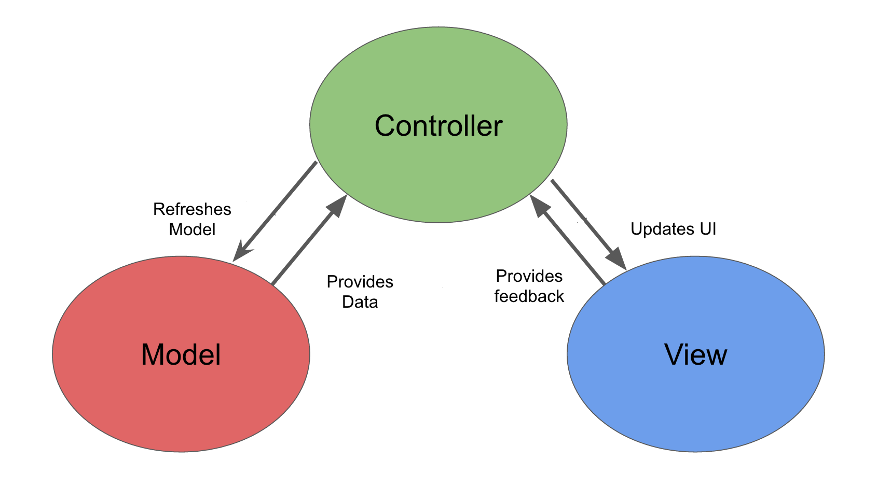
MVC Pattern
MVC Solo
See “Spring-less MVC” DEMO -- Product4aJSP
Notes:
Original SMALLTALK
Xerox Palo Alto Research Center (PARC)

Slide 3
Spring MVC
Distinct Separation of Concerns
Clearly defined interfaces for role/responsibilities “beyond” Model-View-Controller
Single Central Servlet
Manages HTTP level request/response
delegates to defined interfaces
Models integrate/communicate with views
No need for separate form objects
Views are plug and play
Controllers allowed to be HTTP agnostic

Slide 4
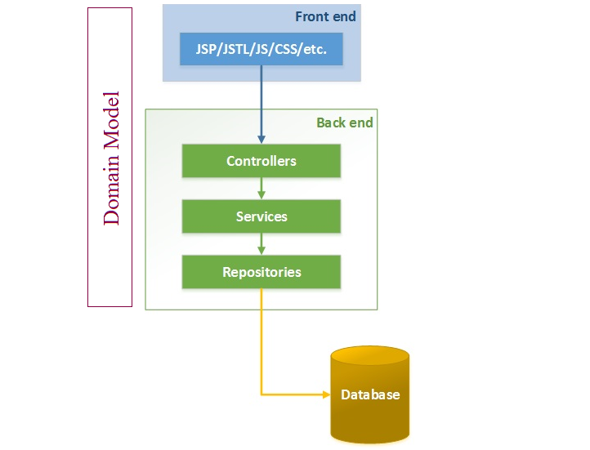
Spring N-Tier With Spring MVC
Presentation Tier
Velocity
FileMarker
ThymeLeaf
PDF
Excel
JSF
XML
JSON

Slide 5
Spring MVC DispatcherServlet
Front Controller
DispatcherServlet - "Front Controller" design pattern
Common pattern used by MVC frameworks
Single Central Servlet that dispatches requests to controllers and offers other functionality that facilitates the development of web applications.
Completely integrated with the Spring container
Able to “exploit” Spring framework features
Has a WebApplicationContext, which inherits all the beans already defined in the root WebApplicationContext.

Slide 6
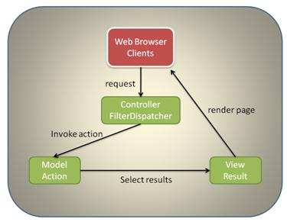
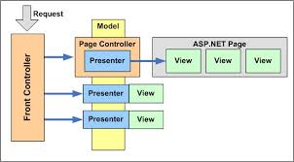
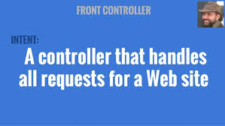
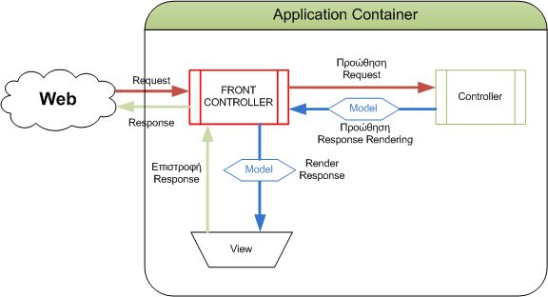
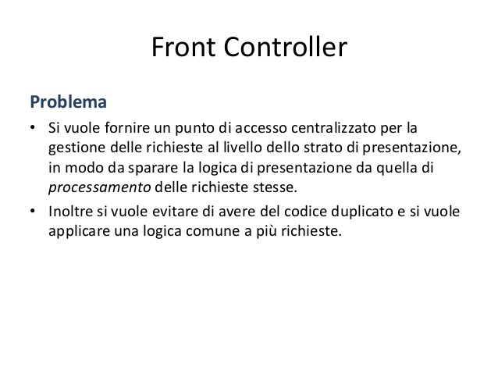
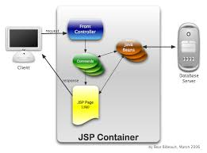
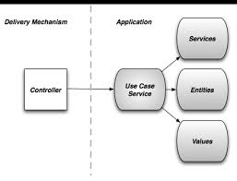

FRONT CONTROLLER

Slide 7
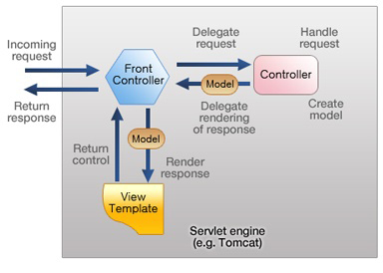
Notes:
http://docs.spring.io/spring-framework/docs/2.5.3/reference/mvc.html
The requesting processing workflow in Spring Web MVC (high level)
http://www.techzoo.org/java
Let’s Implement J2EE Application Controller Design pattern today
Tuesday, August 27, 2013

Slide 8
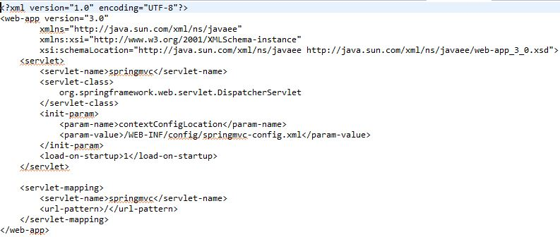
Spring MVC Front Controller Configuration

Slide 9
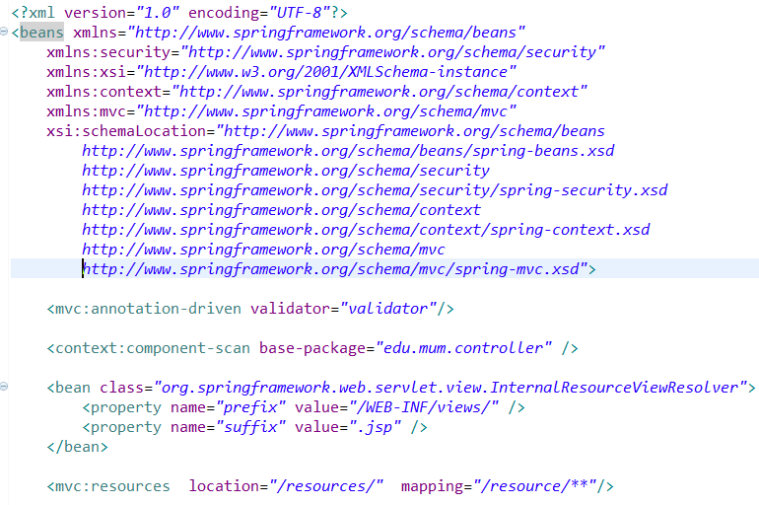
Spring MVC XML Configuration File

Slide 10
XML Configuration file – enable annotations
<context:component-scan base-package= “pkg,pkg…" >
Scans defined packages to find and register @Component-annotated classes and activate basic annotations[e.g. @Autowired] - within the current
application context
<mvc:annotation-driven/>
Enables support for specific annotations [e.g. @RequestMapping, etc.] that are required for Spring MVC to dispatch requests to @Controllers. It is based on MVC XML namespace
<tx:annotation-driven />
Enables support for specific annotations that are required for Spring Transactions @Transaction
See Product4a DEMO

Slide 11
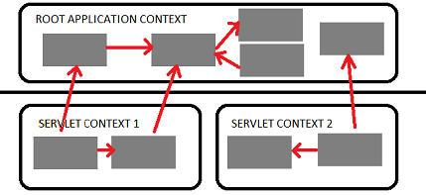

Web Application Context
Spring has multilevel application context hierarchies.
Web apps by default have two hierarchy levels, root and servlet contexts:
Presentation tier has a WebApplicationContext [Servlet Context] which inherits all the resources already defined in the root WebApplicationContext [ Services, Persistence]
Root WebApplicationContext
WebApplicationContext
Presentation tier

Slide 12
Data Binding
Automatically maps request parameters domain objects
Simplifies code by removing repetitive tasks
Built-in Data Binding handles simple String to data type conversions
HTTP request parameters [String types] are converted to model object properties of varying data types.
Does NOT handle COMPLEX data types; that requires custom formatters
Does handle complex nested relationships

Slide 13
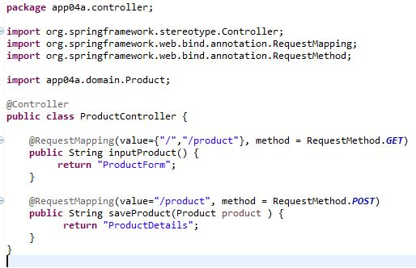
Data Binding example
Product product = new Product();
product.setName(request.getParameter(“name").trim()); product.setDescription(request.getParameter("description").trim());
try {
      price = request.getParameter(“proce").trim());
product.setPrice(Float.parseFloat(price ));
} catch (NumberFormatException e) {
}
Without Data Binding

Slide 14
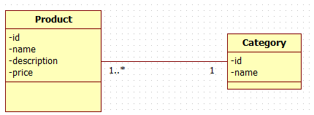
Data Binding - Relationships
<form action="product" method="post">
<legend>Add a product</legend>
<p>
<label for="category">Category </label>
<select name="category.id">
<option value="-">--Select Category--</option>
<c:forEach var="category" items="${categories}">
<option value="${category.id}" > ${category.name}</option>
</c:forEach>
</select>
<label for="name">Product Name: </label>
<input type="text" id="name" name="name" >
See SimpleMVC Demo

Slide 15
Main Point
The basic ingredients of a Spring MVC application include web pages for the view (the known), the back end domain logic and data (knower or underlying intelligence), and the Spring framework and Dispatcher Servlet and managed beans as the controller to connect the view and model. Knowledge is the wholeness of knower, known, and process of knowing.

Slide 16

Spring MVC Annotations
Handler Mapping
Spring Annotations
  @Controller
  @RequestMapping
  @ModelAttribute
  @RequestParam
  @PathVariable

Slide 17
Spring MVC @Controller
Spring implements a controller in a very abstract way, which enables you to create a wide variety of controllers.
Spring Controllers do not extend specific base classes or implement specific interfaces
They do not have direct dependencies on Servlet APIs, although you can easily configure access to Servlet facilities. [actual request, response objects, etc.]

Slide 18
Mapping Example
@Controller
@RequestMapping({"/members"})
public class MemberController {
@Autowired
private MemberService memberService;
@RequestMapping(value={"","/all"}, method = RequestMethod.GET)
public String listMembers(Model model) {
model.addAttribute("members", memberService.findAll());
return "members";
}
@RequestMapping(value="/{id}", method = RequestMethod.GET)
public String getMemberById(@PathVariable("id") Long id,Model model) {
Member member = memberService.findOne(id);
model.addAttribute("member", member);
return "member";
}
See MemberSpringMVC

Slide 19
Mapping Example [Cont.] & Validation
@RequestMapping(value = "/add", method = RequestMethod.GET)
public String getAddNewMemberForm(@ModelAttribute("newMember") Member newMember) {
return "addMember";
}
@RequestMapping(value = "/add", method = RequestMethod.POST)
public String processAddNewMemberForm( @Valid @ModelAttribute("newMember")
Member memberToBeAdded, BindingResult result) {
if(result.hasErrors()) {
return "addMember";
}
memberService.saveFull(memberToBeAdded);
return "redirect:/members";
See Member in MemberSpringMVC for Validation

Slide 20
@RequestParam
Placed on Method argument
http://localhost:8080/MemberSpringMVC/products/product?id=1
@RequestMapping("/product")
public String getProductById(Model model, @RequestParam("id") Long id) {
Product product = productService.findOne(id);
Handling multiple values [e.g., multiple selection list ]
http://localhost:8091/store/sizechoices?sizes=small&sizes=medium&sizes=large
  public String getSizes(@RequestParam(“sizes")String sizeArray[]
Notes:
NOTE: Can be used on POST parameters also – But Why?

Slide 21
@RequestMapping Template with @PathVariable
Facility to pass resource request as part of URL INSTEAD of as a @RequestParam
Conforms to RESTful service syntax
http://localhost:8080/MemberSpringMVC/members/1
@RequestMapping("/{id}")
public String getMemberById(@PathVariable("id") Long id,Model model) {
Member member = memberService.findOne(id);
@PathVariable is used in conjunction with @RequestMapping URL template.
In this case it is a means to get the category string passed in the method signature.
The @PathVariable param needs to be the same as the param in the @RequestMapping
See Member in MemberSpringMVC

Slide 22
Main Point
Annotations are metadata that allow the knowledge about the creation of an object to reside with the object itself
The self-referral nature of Transcendental Consciousness makes all our actions clearer and more powerful

Slide 23
Spring MVC Form Tag Library
Facilitates the development of JSP pages
Integrated with Spring MVC data binding features
Each tag provides support for the set of attributes of its corresponding HTML tag counterpart, making the tags familiar and intuitive to use.
Access Form Tag Library:
<%@ taglib prefix="form" uri="http://www.springframework.org/tags/form" %>
See MemberSpringMVC

Slide 24
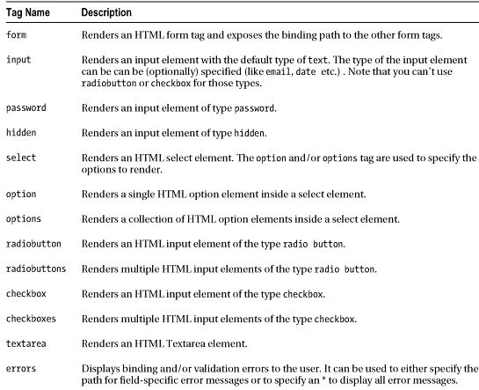
Form Tag Library

Slide 25
Form Tag
This tag renders an HTML 'form' tag and exposes a binding path to inner tags for binding. All the other tags in this library are nested tags of the form tag.
@RequestMapping(value = "/add", method = RequestMethod.GET)
public String AddProduct(@ModelAttribute("newProduct")
Product newProduct) {
<form:form modelAttribute="newProduct" action="add" method="post >
@RequestMapping(value = "/add", method = RequestMethod.POST)
public String saveProduct(@Valid @ModelAttribute("newProduct") Product productToBeAdded, BindingResult result) {

Slide 26
Form examples with HTML output
<form:input id=“name" path=“name"/>
Generated HTML:
<input id=“name" name=“name" type="text" value=""/>
When categories is a LIST
<form:select id="category" path="category.id"
items="${categories}" itemValue="id" itemLabel="name" />
Generated HTML:
<select id="category" name="category.id">
<option value="1">Computing</option>
<option value="2">Travel</option >
<option value="3">Health</option >
</select>
NOTE: path is the “binding Path” defined previously

Slide 27
General Purpose
Spring Tag Library
Not Spring MVC specific
Available to any Java Server Page used in the Spring Framework
Tags for evaluating errors, setting themes and outputting internationalized messages.
<%@ taglib prefix="spring" uri="http://www.springframework.org/tags"%>

Slide 28
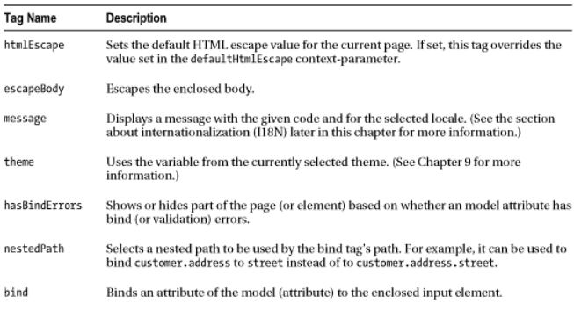
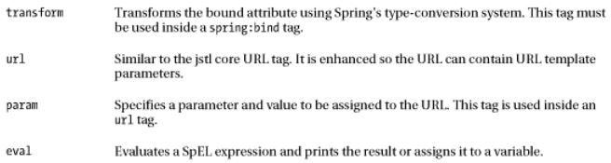
Spring Tag Library

Slide 29
Message Tag
Message tag
Internationalization support through externalization of messages
Text from MessageSource configured in DispatcherServlet
<spring:message code="greeting" text =“Hi" />
“code” isn’t set or cannot be resolved, “text” will be used as default message.
Also, the spring:message- tag, works with the locale support that comes with Spring. [ Internationalization]

Slide 30
Controller return “view”
View Resolver[s] can simplify view declaration
For example with the view resolver:
<bean id="viewResolver" class="org.springframework.web.servlet.view.InternalResourceViewResolver
<property name="prefix" value="/WEB-INF/jsp/"/>
<property name="suffix" value=".jsp"/>
</bean>
return "ProductForm";
resolves to:
/WEB-INF/jsp/ProductForm.jsp
The subsequent RequestDispatcher forward is done by the framework

Slide 31
Main Point
The Spring MVC tag library facilitates JSP development with specialized Form tags.The practice of the TM technique, by structuring the laws of nature in one’s life makes everything go more smoothly.

Slide 32
Spring Web Security
Infinite Diversity Arising from Unity

Slide 33
Cross-cutting Technologies
Servlet Filter
  Generic Servlet/web based filter
Interceptor
  Spring MVC Handler specific Interceptor
Spring AOP
  Simplified AOP implementation- Method level granularity
  Only Spring recognized Beans
  Employs a run time integration [ AKA weaving] process
AspectJ
  Fine grained supports method & field level AOP
  Employs a specialized compilation weaving process
  Works with non-Spring components

Slide 34
FILTER SERVLET
Based on Servlet Specification
Coupled with the Servlet API.
Access to HttpServletRequest and HttpServletResponse objects
Intended for operating on request and response object parameters like HTTP headers, URIs and/or HTTP methods,
Generically applied - regardless of how the servlet is implemented.
EXAMPLES: Authentication , Logging, auditing, UTF-8 encoding
USED in Both Spring Web Security
&& Spring OAuth2

Slide 35
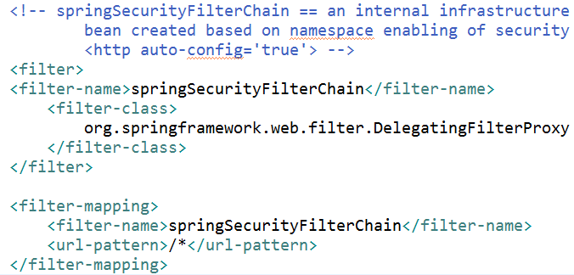
Spring Web Application Security
Servlet Filter based
Spring Security's web infrastructure is based entirely on standard servlet filters.
Agnostic to specific web technology.
Based on HttpServletRequests and HttpServletResponses
Usage:
Browser
Web service client
AJAX application.

Slide 36
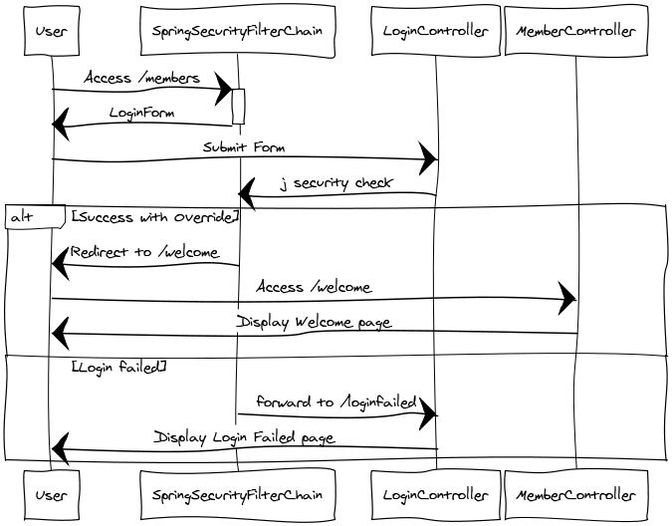
Notes:
/j_security check changed in version 4 to /login
In fact, version 4 changes /j_spring_security_check, j_username, j_password to /login, username, password

Slide 37
Minimal [XML] configuration
Requires all users to be authenticated
Allows users to authenticate with form based login
Allows users to authenticate with HTTP Basic authentication
<security:http use-expressions= "true“ >
<intercept-url pattern="/**" access= “isFullyAuthenticated()“ />
<form-login />
</security:http>
< security:http >
<form-login />
<http-basic />
<logout />
</ security:http >
Notes:
Digest
Special code (called a nonce)
Encrypt username password
MD5

Slide 38
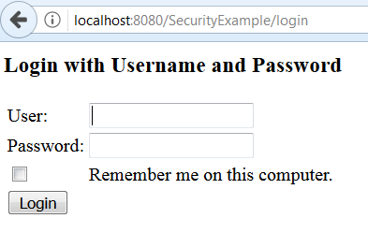
Default Form Based Login
<form-login /> generates a default login form
Available at URL: login
Overridden if attributes are set on <form-login />

Slide 39
Custom Login Configuration
default-target-url – where to go after login is successful
always-use-default-target routes to default-target-url
OTHERWISE routes to where login was triggered
logout-url renames j_security_logout URL
similarly username,password,login-processing renames j_security_* stuff
e.g., /j_spring_security_check is default for login-processing-url
It is replaced by login-processing-url="/postLogin“ [form URL]
<security:form-login login-page="/login"
login-processing-url="/postLogin“
username-parameter="username"
password-parameter="password"
default-target-url="/welcome"
always-use-default-target="true"
authentication-failure-url="/loginfailed"/>
<security:logout logout-success-url="/logout" logout-url= "/doLogout"/>
</security:http>
<security:form-login
login-page="/login"
default-target-url="/welcome"
always-use-default-target="true"
authentication-failure-url="/loginfailed"/>
<security:logout logout-success-url="/logout"
delete-cookies="JSESSIONID" />
Security Version 4
Default values in Version 4

Slide 40
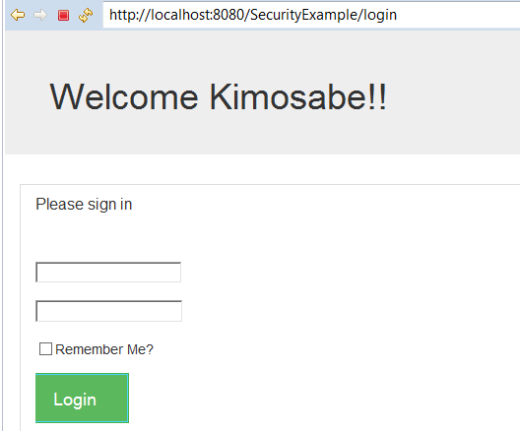
Customized Login

Slide 41
security-context.xml
Authorization
Enable Method level authorization. If here -APPLICATION Level scanned components. For WEB level - need to place in Dispatcher-servlet
<security:global-method-security pre-post-annotations="enabled"/>
security:http enables security filter mechanism.
name space configuration is activated
use-expressions enables SPEL syntax for URL level authorization
<security:http use-expressions="true">
<security:intercept-url pattern="/members" access="hasAnyRole('ROLE_ADMIN','ROLE_USER')" />
<security:intercept-url pattern="/**"
access=“permitAll" requires-channel="https"/>
Notes:
If intercept-url authorization fails and NOT logged in – goto Login page **
If intercept-url authorization fails and ARE logged in – accessDeniedException
** Spring Security handles this automatic triggering of the authentication process with the concept of an Entry Point – this is a required part of the configuration, and can be injected via the entry-point-ref attribute of the security:http element.
to be truly secure, an application should not use HTTP at all or switch between HTTP and HTTPS. It should start in HTTPS (with the user entering an HTTPS URL) and use a secure connection throughout to avoid any possibility of man-in-the-middle attacks

Slide 42
Authorization
Web request authorization using interceptors.
Method authorization using AspectJ or Spring AOP
Common usage pattern
is to perform some web request authorization
coupled with Spring AOP method authorization on the
services layer [more secure].
Notes:
Reference: Security usage of Spring Expression language: SpEL
http://docs.spring.io/spring-security/site/docs/current/reference/htmlsingle/#el-access
3.2. Web Security Expressions
3.3. Method Security Expressions [AOP backed]

Slide 43
URL based Authorization
Patterns are always evaluated in the order they are defined
Configuration:
<security:intercept-url pattern="/members/add"
access= "hasRole('ROLE_ADMIN')" />
Method level Authorization
Configuration:
<security:global-method-security
pre-post-annotations="enabled"/>
MemberServiceImpl.java
@PreAuthorize("hasRole('ROLE_ADMIN')")
public void save( Member member) {
memberRepository.save(member);
}

Slide 44
Main Point
Authentication & Authorization underlie the entire web application. They provide a shield that makes the application invulnerable.
Transcendental consciousness is characterized by the quality of invincibility, which means one cannot be overcome or overpowered

Slide 46
Main Point
The different technologies [Filter, Interceptor, AOP] available in Spring, together provide a thorough solution to cross cutting concerns.
Creative intelligence enhances and strengthens uniquely differing values in life in a comprehensive way.

